Slide 1
RA 505 Robot Sensing and Vision Lecture 36
Dr. Rishikesh Kulkarni
Department of Electronics and Electrical Engineering
IIT Guwahati

Slide 2
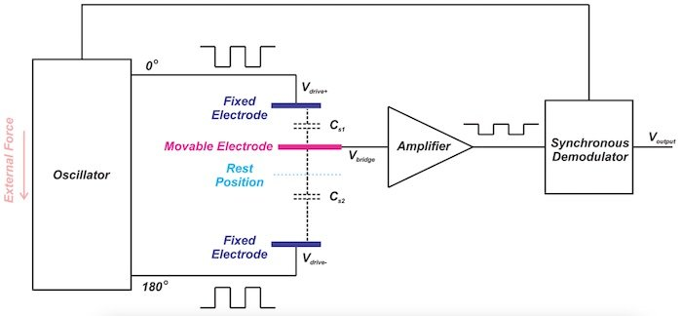
Capacitive Accelerometer
Spring-mass system
Change in capacitance due to change in distance between movable and fixed plate

Slide 3
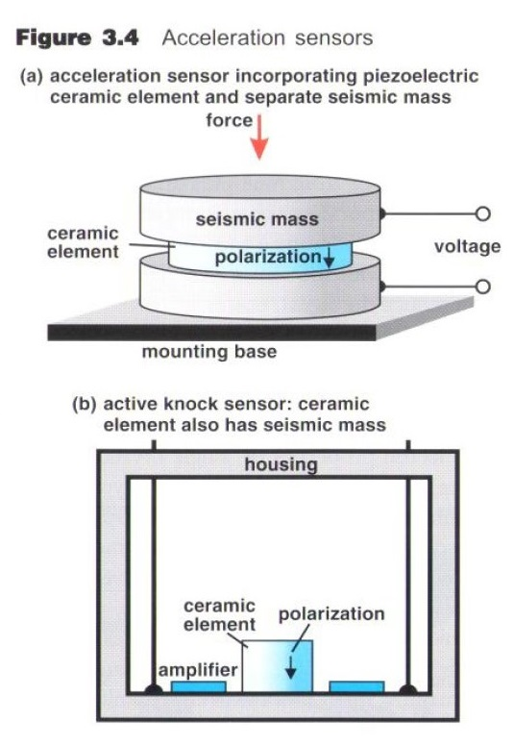
Piezoelectric Accelerometer
Piezoelectric material slice: Polarized ceramic
Advantages
Frequency response
Temperature stability
Ruggedness
Adaptability
Electrical characteristics

Slide 4
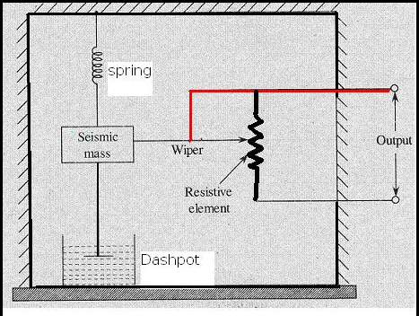
Potentiometric Accelerometer

Slide 5
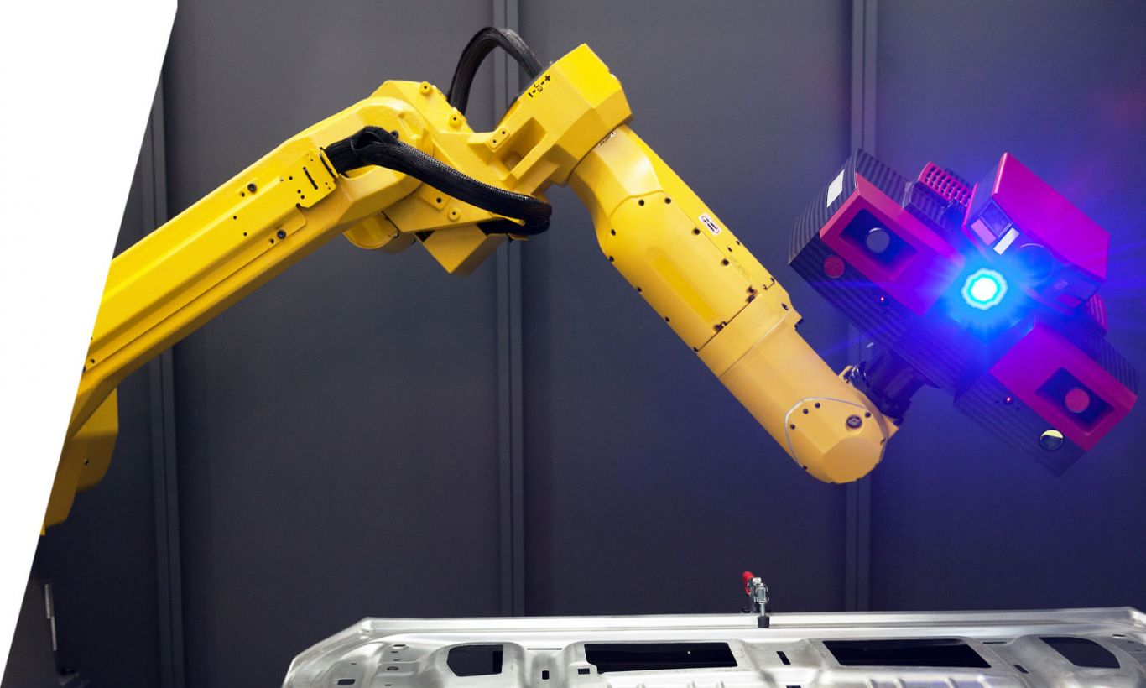
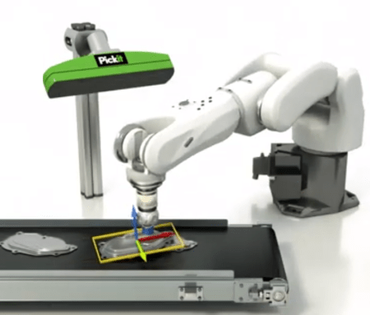
Structured Light Illumination
Introduction
Principle of Method
Triangulation
Fringe Projection
Phase Evaluation
Phase Calibration
Applications of Method
Line Scan and Fringe Projection
Quality Guided Phase Unwrapping
Multifrequency Fringe Projection
Carrier Phase Removal
360-degree Fringe Projection
Concluding Remarks

Slide 6
Introduction
Data-processing methods based on those developed for interferometry
Interferometry is based on the optical path difference and fringe projection profilometry is based on principle of triangulation.
Projection of a pattern generated using gratings or a digital projector.

Slide 7
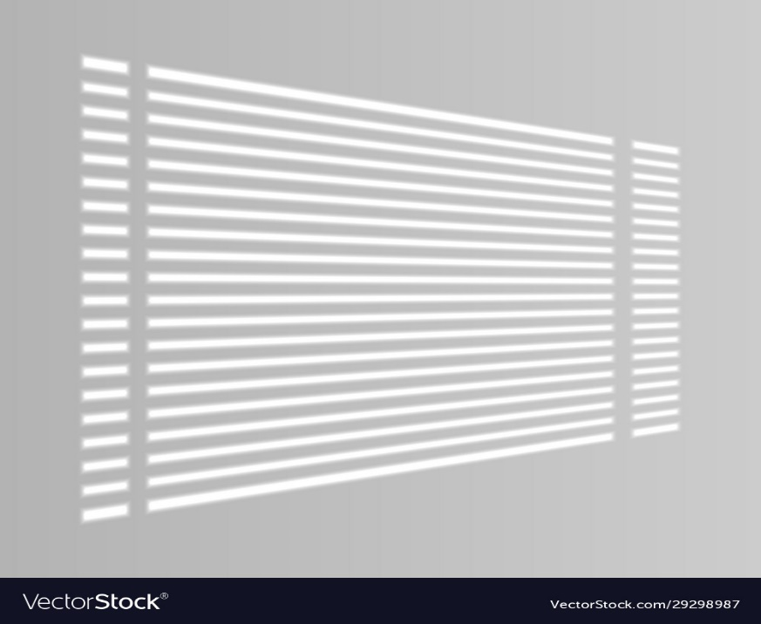
Principle of Method
Principle of FPP is based on ‘Principle of Triangulation’.
Quantitative phase evaluation and calibration of the phase values against standard results yields the actual profile of an object.

Slide 8
Fringe Projection
How do we obtain a whole-field depth map of an object?
Line-scan method

Slide 9
Fringe Projection: Line-scan method

Slide 10
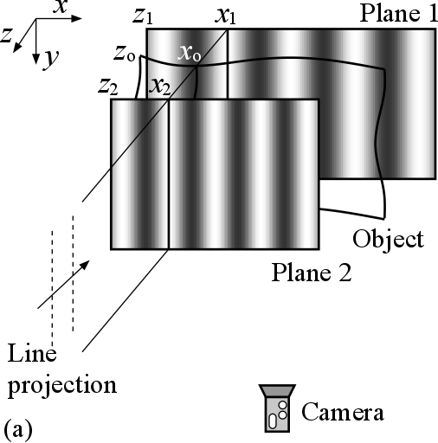
Fringe Projection: Phase-based method
Advantages of using a fringe pattern
One single image would provide information on the entire surface and hence scanning is not needed.
The problem of a gap between two projected lines no longer exists as every point on the surface is sampled.
The order of a phase value at each point can be detected accurately by various methods (discussed next).
The accuracy is related to that of phase measurement, which is much higher than the accuracy of the line detection method.

Slide 11
Phase Evaluation
In the fringe projection method, it is important to obtain the correct phase for each pixel of a fringe pattern.
This is carried out in two steps: wrapped phase extraction and phase unwrapping.
Fourier Transform:
The spatial intensity distribution of a fringe pattern is sinusoidal in the direction of progressing phase

Slide 12
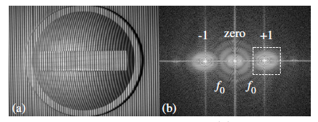
Phase Evaluation: Fourier Transform

Slide 13
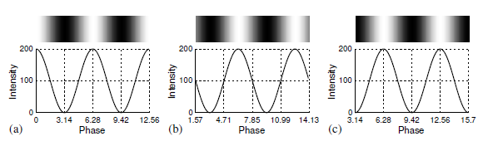
Phase Evaluation: Phase-Shifting
Phase-shifting method requires the input of at least three phase-shifted fringe patterns as in a sinusoidal intensity distribution there are three unknowns.
Generating a phase-shifted fringe pattern is straightforward: this is done by changing the initial phase of a fringe pattern and project them sequentially onto the object

Slide 14
Phase Evaluation: Phase-Shifting
The intensity of a pixel in a fringe pattern, which is phase-shifted n times, is expressed as
If n is 3, the unknowns a, b and θ can be determined. If n is more than 3, the unknowns can be obtained using least-squares error.
Let and

Slide 15
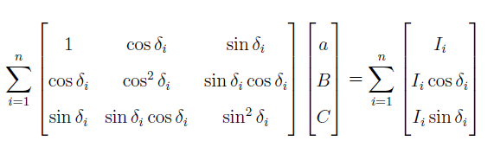
Phase Evaluation: Phase-Shifting

Slide 16
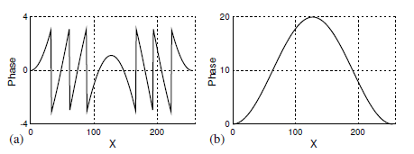
Spatial Phase Unwrapping
After obtaining a wrapped phase map, the next step is to unwrap the phase values to recover a continuous phase distribution without a 2π jump.
The problem of phase unwrapping becomes significantly complicated in 2D due to the many possible unwrapping paths (as oppose to only one path in the 1D case)

Slide 17
Quality Guided Phase Unwrapping
A particularly effective approach for phase unwrapping is known as quality- guided phase unwrapping.
It relies on a quality map to determine an unwrapping path.
At each step, after the current pixel is processed, the next pixel to be processed is determined by a pixel with the highest quality on the propagation boundary.
This method ensures the unwrapping path moves quickly to a higher quality region before moving to a lower quality region where errors are more likely to be encountered.
The method is effective for phase fringes where the fringe contrast, which is defined as the ratio between the modulation and background intensity: b/a, is an accurate quality indicator.
The modulation and background intensity can be obtained from the phase-shifting algorithm.
Low fringe contrast is usually due to a dark region where a light beam is not able to reach, resulting in a low signal-to-noise ratio, consequently inaccurate results.
The quality-guided phase unwrapping algorithm would process these low fringe contrast regions at the last stage to minimize error accumulation.

Slide 18
Temporal Phase Unwrapping
Though spatial phase unwrapping is speedy and requires only one wrapped phase map, there are certain limitations.
For example, if an object profile is complicated, spatial phase unwrapping often produces suboptimal results.
In cases where a field of view contains multiple objects whose profiles are disconnected or of different heights, spatial approach may not be able to produce the intended results.
Unlike spatial phase unwrapping that relies on a pixel’s neighbouring pixels to determine its phase value, temporal phase unwrapping deals with each pixel individually
The method relies on different calculated phase values of a pixel to determine its actual phase value.

Slide 19
Temporal Phase Unwrapping
Multi-frequency fringe projection
Temporal phase unwrapping procedure
Note that the unwrapped phase map always contains the highest frequency of the fringes.

Slide 21
Temporal Phase Unwrapping

Slide 22
Phase Calibration
Calibration of a fringe projection system may vary according to its applications.
If a phase-to-height relationship is required, one may measure an object with a known height and obtain a phase-to-height coefficient by removing the carrier phase component from the unwrapped phase map.
If a 3D reconstruction of an object is the goal, a full 3D calibration is required.
Carrier phase removal
Carrier fringe deformation which results in phase variations of the fringes would provide the surface profile information of an object.
As it is the phase variation and not the original phase of the carrier fringes that is of interest, the latter should be removed from an unwrapped phase map

Slide 23
Phase Calibration: Carrier phase removal
Determine the component by a 2D polynomial function
Coefficient estimation: Least-squares

Slide 24
Phase Calibration: Carrier phase removal

Slide 25
Phase Calibration: Multi-reference-plane
Measurement pf a reference plane at several axial distances (along the z-axis) with each incremental distance kept reasonably small.
An unwrapped phase map (without phase removal) at each position is then recorded.
After the unwrapped phase values of an object are calculated, each pixel phase (θ₀) is compared with the corresponding pixel phase in the reference planes.
The nearest two reference planes are obtained (phase 1 and 2) and each pixel position (along the z-axis) is interpolated from two reference positions based on the ratio of (θ₀- θ₁)/(θ₀ − θ₂).

Slide 26
Application of Method

Slide 27
Quality guided phase unwrapping

Slide 28
Multi-Frequency Fringe Projection

Slide 29
Multi-Frequency Fringe Projection

Slide 30
Carrier Phase Removal

Slide 31
360-degree Fringe Projection

Slide 32
Summary
Principle of Fringe Projection Profilometry
Steps involved in calculating height from phase
Phase unwrapping techniques
Practical issues
Examples

Slide 33
References
L Chen C Quan and CJ Tay, Digital Fringe Projection Profilometry, in Digital Optical Measurement Techniques and Applications, Artech House, 2015.

